Slide 1
Customer analytics
Understanding Your Customer

Slide 2
At a glance
Understanding your customers
  What?
  Why?
  Who?
  How?

Slide 3
Customer analytics – What
a process by which data from customer behaviour is used to help make key business decisions via market segmentation and predictive analytics. This information is used by businesses for direct marketing, site selection, and customer relationship management.
- Wikipedia

Slide 4
5 Key Business Tips
Understand how “normal” customer behaves
Measure Changes over time
Know and understand Customer Life Cycle
Measure Return on Investments
Know your key metrics
Notes:
Changes in customer behaviour means you can take action. Improve R/S
Monitor key metrics. Know your customer defection and acquisition rates.
Dashboard info should lead you to take action, else why are you monitoring?
Don’t include irrelevant data or data that you cannot do anything about.

Slide 5
Customer analytics – Why?
Identify changes to customer behaviour
Customers bring in the $
Limited funds for customer engagement
Want the best results with the least resources
Deliver the right message to the right customer > Higher conversion rate

Slide 6
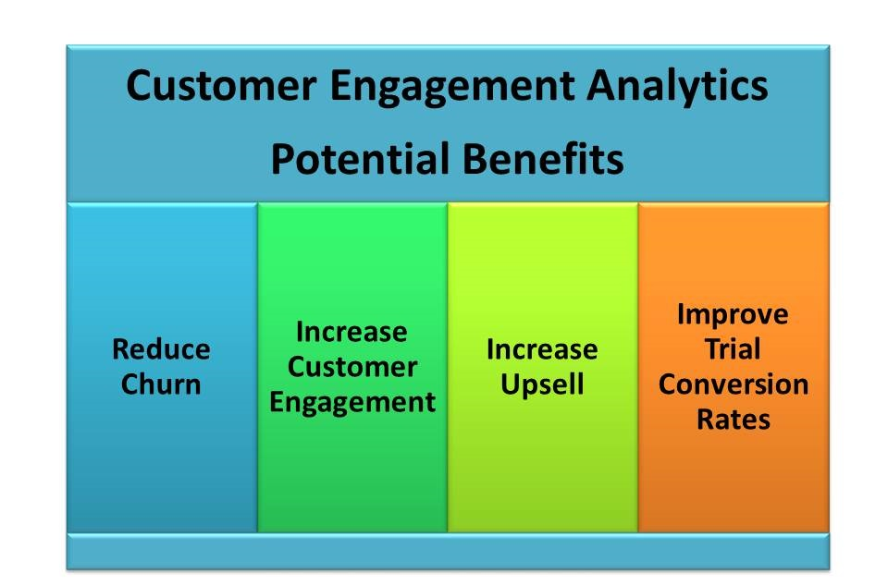
Customer analytics – Why?
Notes:
Churn - the percentage rate at which customers stop subscribing to a service
Discuss the 4 potential benefits of customer analytics.
Reduce customer churn – identify customers about to leave and put them on retention program schemes
Increase customer engagement – let loyal customers feel valued and important. Make them feel like they are winning.
Increase upsell – encourage customers to buy more (of same product or more variety)
Improve trial conversion rate – market the right campaigns to the right customers so as to improve take up rates

Slide 7
Customer analytics – Who?
Identify who is your customer
  Whose data to collect? Who to market to?
  Eg if he last bought from you 10 years ago, is he still your customer? If he only bought 1 unit over last 5 years?
  Different definition depending on industry. Eg Bread (daily) vs Property (years)
Customer should be someone who bought from you in the past, and is expected to buy from you in the future

Slide 8
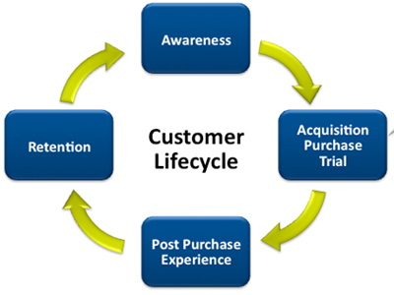
Customer life cycle

Slide 9
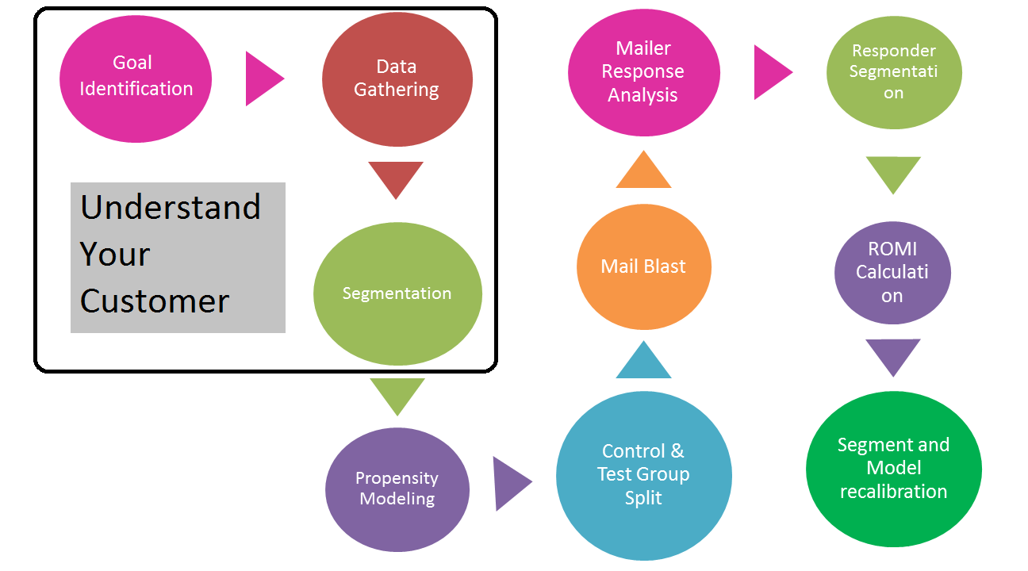
Customer Analytics – How?

Slide 10
Identify goals
Attract new customers?
Make existing customers profitable?
Identify high risk customers?
Retain profitable customers?
Win back lost customers?
Increase sales?
Improve customer satisfaction?

Slide 11
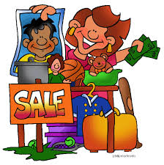
Collect data
What data to collect?
Whose data to collect?
When to collect?
  Before they buy from you?
  When they make first purchase?
  Ten years after their last purchase?

Slide 12
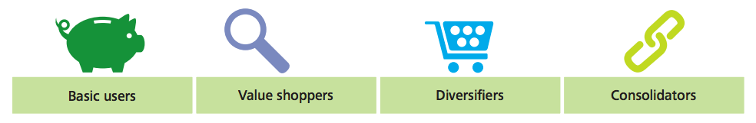
Customer segmentation
Customers that are more profitable should be treated differently
Knowing which customers are more valuable, which lack potential, which can be better engaged to maximise their potential is critical
How much did I spend on this customer? What is my ROI?

Slide 13
Customer segmentation
Segment - grouping customers with similar needs and responses
  Demographic (age, gender, race etc)
  Geographic (location)
  Psychographic (lifestyle, personality, interests etc)
  Behavioural (buying stage, benefit sought, product use etc)
  Past business history (purchase history, frequency, amount etc)
  etc
Notes:
For customer analytics, we are looking at past business history,
Defining customer profiles based on their previous buying patterns

Slide 14
Customer Profiling
2 types of profiles
  Descriptive (married, 2 children, lives in city, reads Straits Times)
  Behavioural (visit website every day lunch time, then stops for a week)
Both important depending on context
  Content of website – descriptive profile will be more helpful
  Relationship with biz – behavioural profile is a very good predictor
  Combination of both is invaluable
Notes:
Who are these customers who bought this much from us?
FAQ: difference between customer segment and profile?
Ans: profiles tell you how the customer segments differ

Slide 15

Customer Profiling Example
Notes:
Who are these customers who bought this much from us?
FAQ: difference between customer segment and profile?
Ans: profiles tell you how the customer segments differ

Slide 16
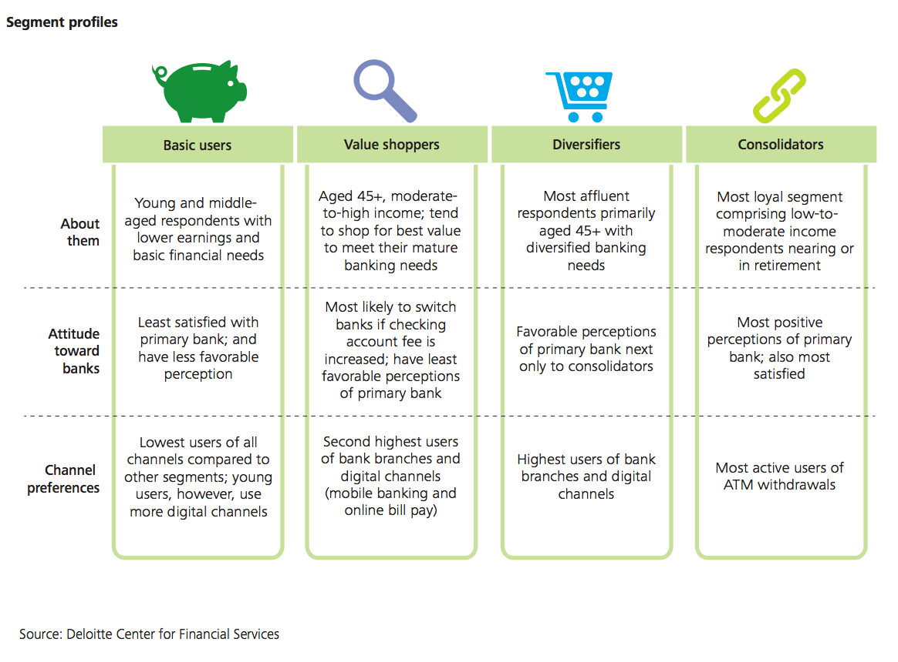

Slide 17
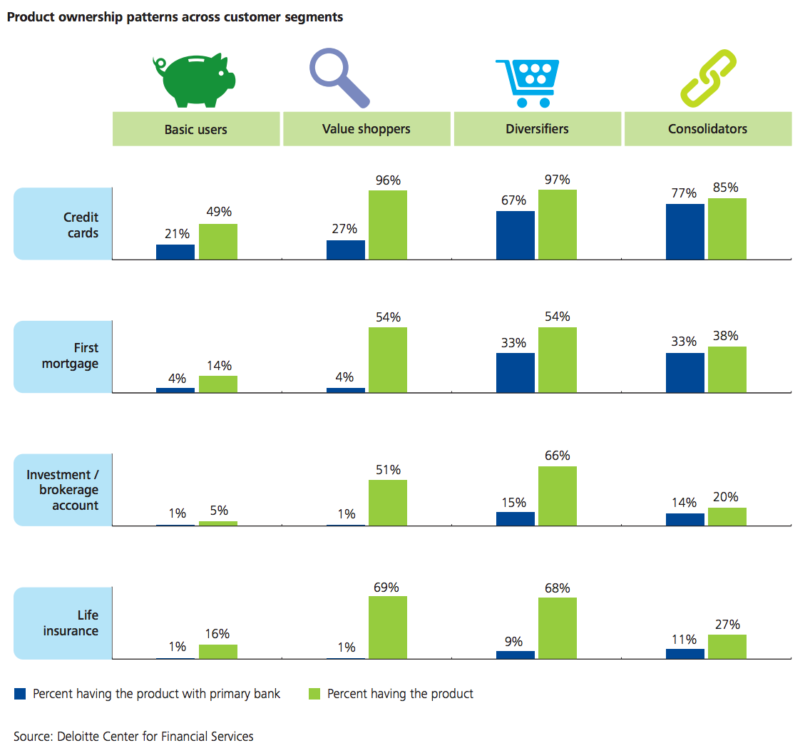

Slide 18
Customer Analytics
What?
  Improving customer relationship
Why?
  Maximise ROI
Who?
  Define your customer
How?
  Business goal > collect data > segment customer > MARKETING CAMPAIGN
Notes:
Leads to next topic

